Slide 1
Effective population size
What is it?
Why does it matter?
How do you estimate it?
What are effects of age structure?
N_{e} in the age of genomics
Robin Waples
Seattle, Washington USA

Slide 2
N_{e}: some background
Demographic consequences of population size (competition, predation, birth and death rates) depend on the census size (N)
Evolutionary consequences of population size (rate of genetic drift—change in allele frequency, loss of genetic diversity, increase in inbreeding) depend on the effective size (N_{e})

Slide 3
Effective population size determines the rate (or the equilibrium state)
of many evolutionary processes
Rate = f(1/N_{e})

Slide 4
Effective population size
The size of an “ideal” population with the same rate of inbreeding or genetic drift as the population in question
Definition of a limit
For every real ε > 0 there exists a real δ > 0
such that for all x with 0 < |x − c | < δ,
we have |ƒ(x) − L| < ε

Slide 5
N_{e} as a lottery
In a Wright-Fisher (ideal) population, everybody has the same number of tickets, and sampling is with replacement.
  In that case, V_{k} ≈ k and N_{e} ≈ N.
In most real populations, the lottery is rigged in favor of certain individuals who have a lot of tickets, while others have few or none.
Statifying the population into winners and losers increases V_{k} and reduces N_{e}/N.
_

Slide 6
Factors that stratify a population and
reduce N_{e} within generations
Separate sexes
  This requires two lotteries
  Members of the less-numerous sex have fewer competitors and leave more offspring/parent
  This increases overall Vk and reduces Ne
  Effect is minor unless skew is very strong

Slide 7
Stratification within generations, cont.
Some individuals are more equal than others
Some parents are more fit
  They have more tickets in the lottery
  Their offspring survive better
Family-correlated survival
Entire families survive or die as a unit
  A cow stomped on a nest of salmon eggs
  A batch of larvae strike it rich
Can theoretically produce ‘sweepstakes’ reproductive success and tiny Ne/N ratio a la Hedgecock

Slide 8
Stratification within generations, cont.
Iteroparous species
N_{e} depends on lifetime variance in reproductive success
In age-structured species, some individuals are more
equal than others because they survive to reproduce
many times (they enter more lotteries)
Also, fecundity (number of lottery tickets) often changes
with age
Important to consider both N_{e} per generation and N_{b} per year or season

Slide 9
Stratification across generations
Changes in population size over time
Replacement
Gen N rate
1 | 1000000 | 0.500
2 | 500000 | 1.600
3 | 800000 | 0.001
4 | 1000 | 275.000
5 | 275000 | 3.273
6 | 900000
Stratification
by time
Long-term N_{e} is the harmonic mean

Slide 10
The ratio
effective size : census size
Assuming constant N
(so k = 2):
_

Slide 11
Contribution to ratio N_{e}/N
Frankham 1995
Factor N_{e}/N
Sex ratio (S) 0.64
Variance (V) 0.46
S + V 0.35
S + V + variable N 0.11*
}
Within gen
N_{e}/N should be ~ 0.5 and only rarely as low as 0.25
Nunney 1993

Slide 12
How big does N_{e} have to be?
  50 Δf = 1/2N_{e} = 0.01 is tolerated in livestock
  500 balance between mutation and loss of additive variation
  5000 avoid mutational meltdown
** All this applies to closed populations **

Slide 13
Genetic estimates
of N_{e}
Idea
(Krimbas and Tsakas 1971)
Use rate of genetic change
to estimate Ne

Slide 14
Genetic methods can provide
information about:
Long-term N_{e}
Bottlenecks
Contemporary N_{e}

Slide 15
Long-term N_{e} estimates assume equilibrium conditions, neutrality, panmixia,
and a specific mutation rate
θ = 4N_{e}u = H/(1-H)
N_{e} = [H/(1-H)]/4u
Assumes
u = 10⁻⁷

Slide 16
n = 4 pops
N = 100/pop

Slide 17
Key points: diversity and N_{e}
H, θ, and related long-term indicators of effective size relate to global or metapopulation N_{e}
Local samples provide information about local N_{e} only under ~ complete isolation
Errors of inference regarding local or metapop N_{e} are possible in either direction

Slide 18
Methods that estimate contemporary N_{e}
Two samples
Temporal change in allele frequency
Changes in genetic diversity
One sample
  Linkage disequilibrium
Heterozygote excess
Approximate Bayesian Computation (ABC)
Sibship

Slide 19
Temporal estimates of N_{e}
5 generations
0
1
2
3
4
5
6
7
8
First
sample
Second
sample
Index of allele frequency change (F)

Slide 20
Likelihood versions of the
temporal method
Several are available
Wang (2001) pseudo-likelihood most popular
Can increase power and precision, esp with low frequency alleles
Must specify upper bound for Ne

Slide 21
Linkage disequilibrium (LD)
Non-random associations of alleles at different loci (e.g., allele A at locus 1 with allele b at locus 2)
Most population genetic analyses assume that the loci behave independently, in which case the frequency of the Ab gamete is just the product of the two allele frequencies
LD occurs when this is not true. Possible causes:
Selection
Migration or mixture
Genetic drift (small population size)
Physical linkage (same chromosome)
Hill 1981

Slide 22
If loci are not physically linked,
leading to
With linkage, also depends on recombination rate, c
Hill 1981

Slide 23
LDNe
S=100

Slide 24
A word about negative estimates of N_{e}
Temporal
Disequilibrium
^
N_{e} < 0 should be interpreted as ∞

Slide 25
Approximate Bayesian Computation
(ABC) methods
Do not depend on expectations or likelihoods of specific genetic indices
Simulate many different N_{e}’s and track genetic indices
Find N_{e} that produces best fit to data
Temporal method published; single- sample estimator ONESAMP
Tallmon et al. 2004; 2008

Slide 26
Other single-sample estimators
Heterozygote excess (Pudovkin et al. 1996). Limited application: small Ne, large samples, lots of loci
Molecular coancestry (Nomura 2008). More powerful than hets-excess method. Combined estimates even better.
Sibship analysis (Wang 2009). More powerful than hets-excess method. More powerful than temporal method unless t >>1. More robust to different mating systems?

Slide 27
Assumptions for methods that
estimate contemporary N_{e}:
No migration
No selection
Mutation is unimportant
Discrete generations
Random sampling of an entire generation
Loci not physically linked
Reliable data

Slide 28
What time periods do estimates
of N_{e} apply to?
Single-sample estimates
  To the parents that produced the sample
Temporal estimates
  Generations 0 through (t-1)
  No information about N_{e(t)}
Waples 2005

Slide 29
Genetic estimates of N_{e:} Summary
Contemporary
precision is limiting factor, esp for large N
sampling issues important
numerous simplifying assumptions, most not rigorously evaluated (esp for computationally intensive methods)
Long-term
very sensitive to assumptions (esp selection, mutation, migration)
Both benefit from proliferation of number and types of markers, but this also introduces challenges

Slide 30
Two special topics
Single-sample estimates with overlapping generations
LD in the age of genomics

Slide 31
Jorde & Ryman 1995, 1996
Modified temporal method for age-structured populations
Requires samples from consecutive cohorts
Requires detailed demographic data (~ Leslie matrix)
Produces robust estimates if assumptions met and
appropriate samples and data are available
Waples & Yokota 2007
Evaluated bias in standard temporal method for age-structured populations
Bias depends on species’ life history and exp. Design
Bias is smaller when many generations separate samples

Slide 32
Single-sample estimates
with overlapping generations
What is the relationship between N_{e} (per generation) and N_{b} (per year or breeding cycle) in iteroparous species? (Waples et al. 2013)
What do single-sample genetic methods estimate when generations overlap:
  N_{e}? N_{b}? Something else?
                (Waples et al. 2014)

Slide 33




Collaborators:
Gordon Luikart
U. Montana
Jim Faulkner
NOAA, Seattle
Tiago Antao
Cambridge
Oxford
Liverpool
Missoula
David Tallmon
U. Alaska, Juneau

Slide 34
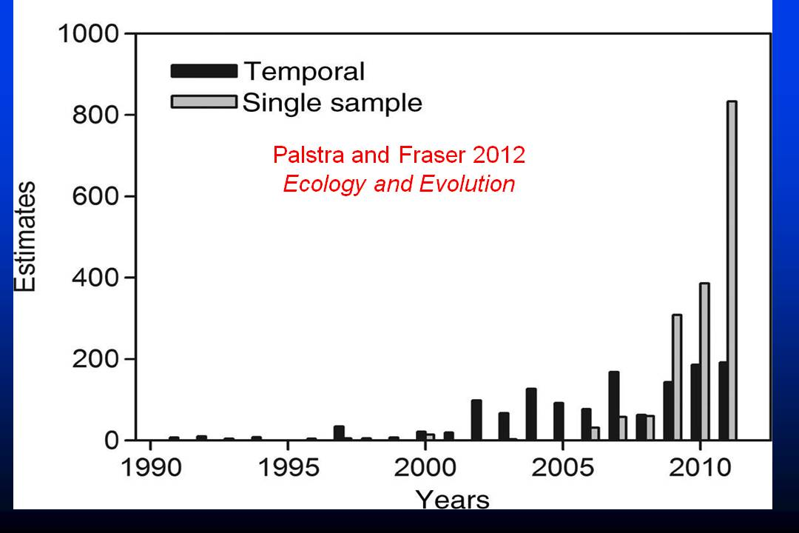
Why care about N_{b} / N_{e}?
N_{b} is easier to estimate in iteroparous species, so lots of estimates are accumulating in the literature
  Parentage analysis
  Single-sample genetic methods
Many/most of these estimates apply more
to Nb than to Ne

Slide 35
What is the N_{b} / N_{e} ratio in iteroparous species?
How does it depend on the species’ life history?
What was known:
Discrete generations: N_{e} = N_{b}
Pacific salmon / annual N_{e} ≈ gN_{b}
plants w/seedbanks
What was suspected:
Overlapping generations: N_{b} < N_{e} < gN_{b}

Slide 36
Overlapping generations
Hill (1972, 1979)
Discrete generations
inbreeding effective size
Crow & Denniston (1988)
_
k = mean number of offspring per parent
V_{k} = variance in k within one time period
V*_{k} = lifetime variance in k
N₁ = number of offspring produced per time period
N = number of adults alive at one time
G = generation length = average age of parents
Notes:
36
36

Slide 37
Notes:
37

Slide 38
Results suggest that with only a little simple life history information, it now will be possible to translate estimates of N_{b} into estimates of N_{e} per generation
Notes:
38
38

Slide 39
^
Distribution of N_{b} /(true N_{b})
Primrose
Sagebrush
Seaweed
Crab
Mosquito
Sea urchin
Bighorn
Bison
Dolphin
E seal
Grizzly
Red deer
Great tit
Sage grouse
Sparrow
Brown trout
Cod
Sardine
Snake
Cascade frog
Wood frog
Using LD method with single-cohort samples

Slide 40
Pattern of bias in Nb^ is almost perfectly explained by the true ratio
Nb/Ne.
From PRSLB paper we know we can estimate Nb/Ne with some simple life history information
Should be able to adjust bias in Nb^ and translate Nb^ into Ne^
Robinson and
Moyer 2012
true

Slide 41
^
Why does bias in N_{b} depend on N_{b} /N_{e}?
r² due to drift has two components:
1. New LD generated in current time period
(depends on N_{b}).
2. Background LD from previous time periods
(depends on N_{e}).
With discrete generations, no bias at equilibrium
With age structure, no bias if N_{b} = N_{e}

Slide 42
More detailed results for a few species
Pattern of bias depends on Nb/Ne ratio and the type of samples

Slide 43


LD in the age of genomics
Collaborators:
Ryan Waples
Wes Larson

Slide 44
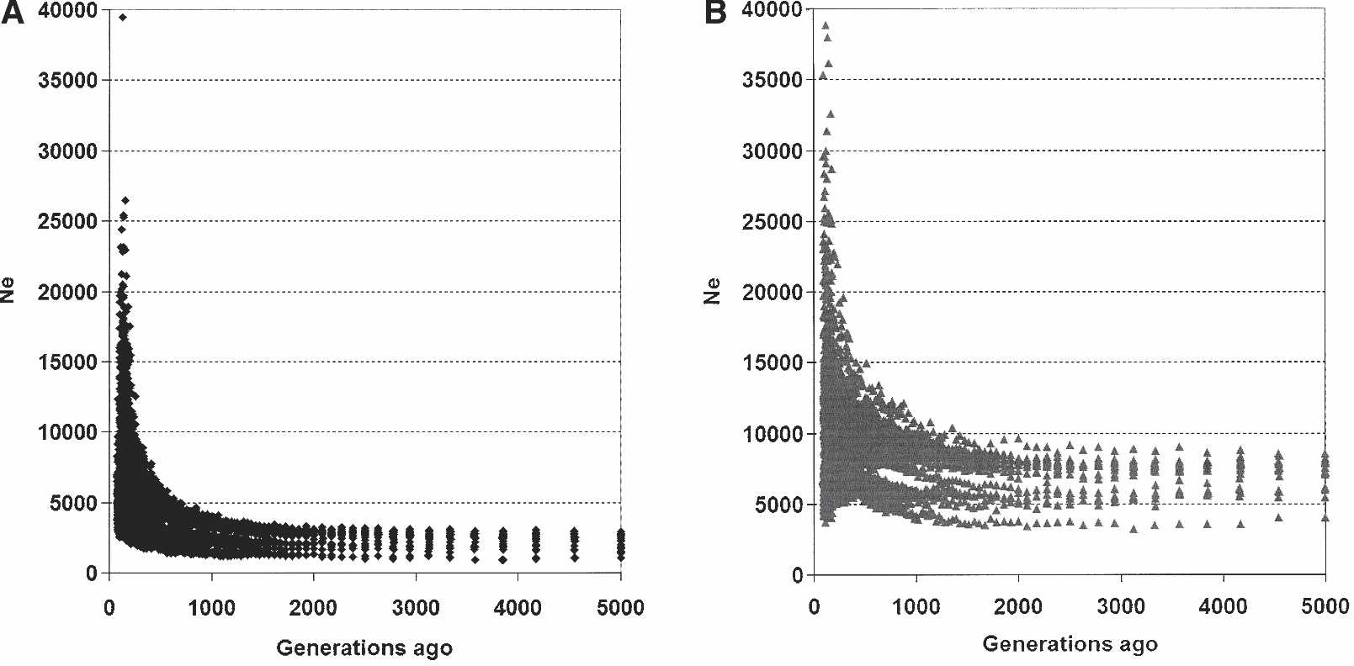
Estimates of
human Ne
based on LD
at linked loci
If linkage relationships are known, precision is higher and different loci estimate Ne in different time periods
Tenesa et al. 2007

Slide 45
Complications for non-model species
In most cases, linkage relationships not known
but …
With 1000s of loci allocated to a relatively few
chromosomes, “no linkage” assumption not viable
How much is mean r² biased by linkage?
Can the bias be corrected or removed?
What if you just ignore linkage?
How does linkage affect precision?

Slide 46
Strategies for dealing with bias
Identify linked loci and remove one of each pair
  Use a map
  High r² in multiple populations
In a single population:
  Truncate r² values above a threshold
  Develop a bias correction
Ignore the problem

Slide 47
Strategies for dealing with bias
Identify linked loci and remove one of each pair
  Use a map
  High r² in multiple populations
In a single population:
  Truncate r² values above a threshold
  Develop a bias correction
Ignore the problem

Slide 48
Simulations
Randomly scatter L loci on each of Y chromosomes
Use mapping function to translate distances (cM)
into recombination rate (c)
Use SimCoal to generate quasi-equilibrium genetic composition, for given Ne and u
Use SimuPop for a few generations to generate
data to sample
Calculate r² for each pair of loci and examine
patterns

Slide 49
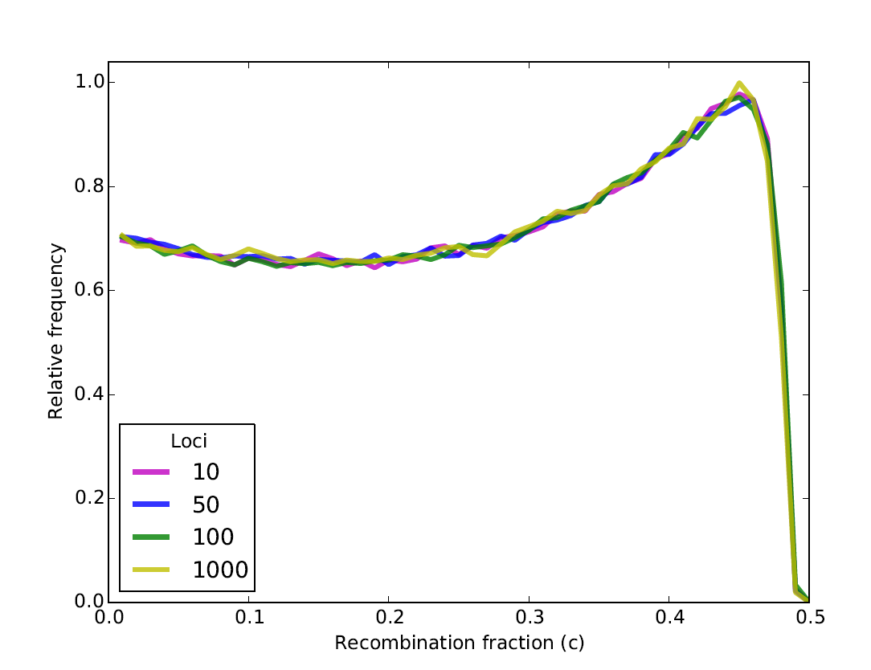
For a single chromosome, the fraction of locus pairs with specific recombination values is INDEPENDENT OF THE NUMBER OF LOCI

Slide 50
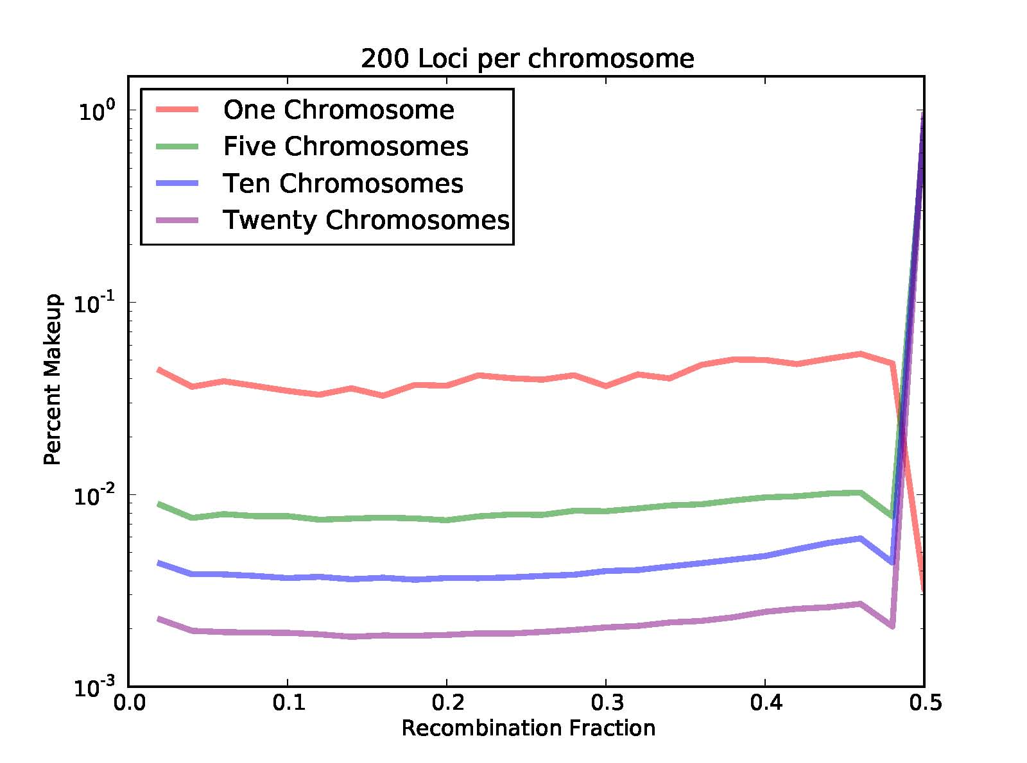
Each additional chromosome dilutes the overall fraction of linked loci

Slide 51
Simulated data for unlinked loci
Expected = simple function of overall mean

Slide 52
Observed data for a real species (Chinook salmon)
Wes Larson et al.
2014 Evol Apps
Can we identify and remove ‘outlier’
LD values?

Slide 53
Simulated data for 4 chromosomes with linkage

Slide 56
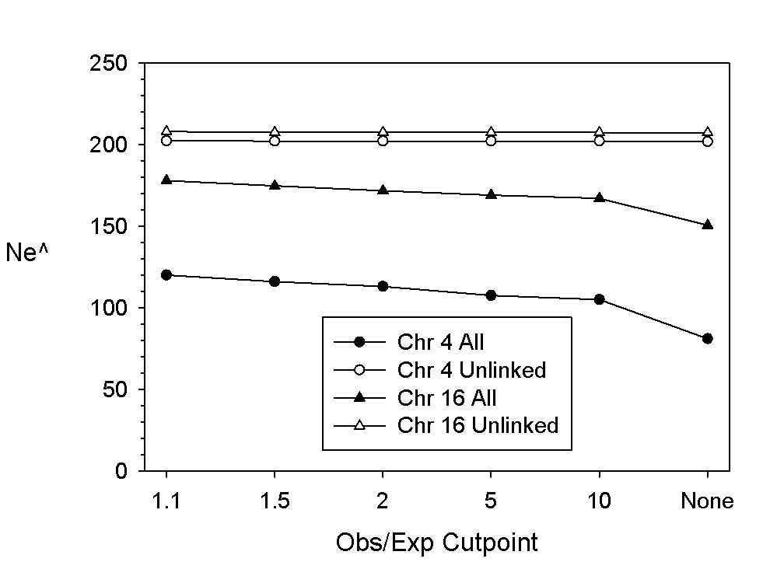
One-pass truncation of outlier r^2 values only removes part of the bias
Repeated truncation of outlier r^2 values is prone to overshoot true mean r^2

Slide 57
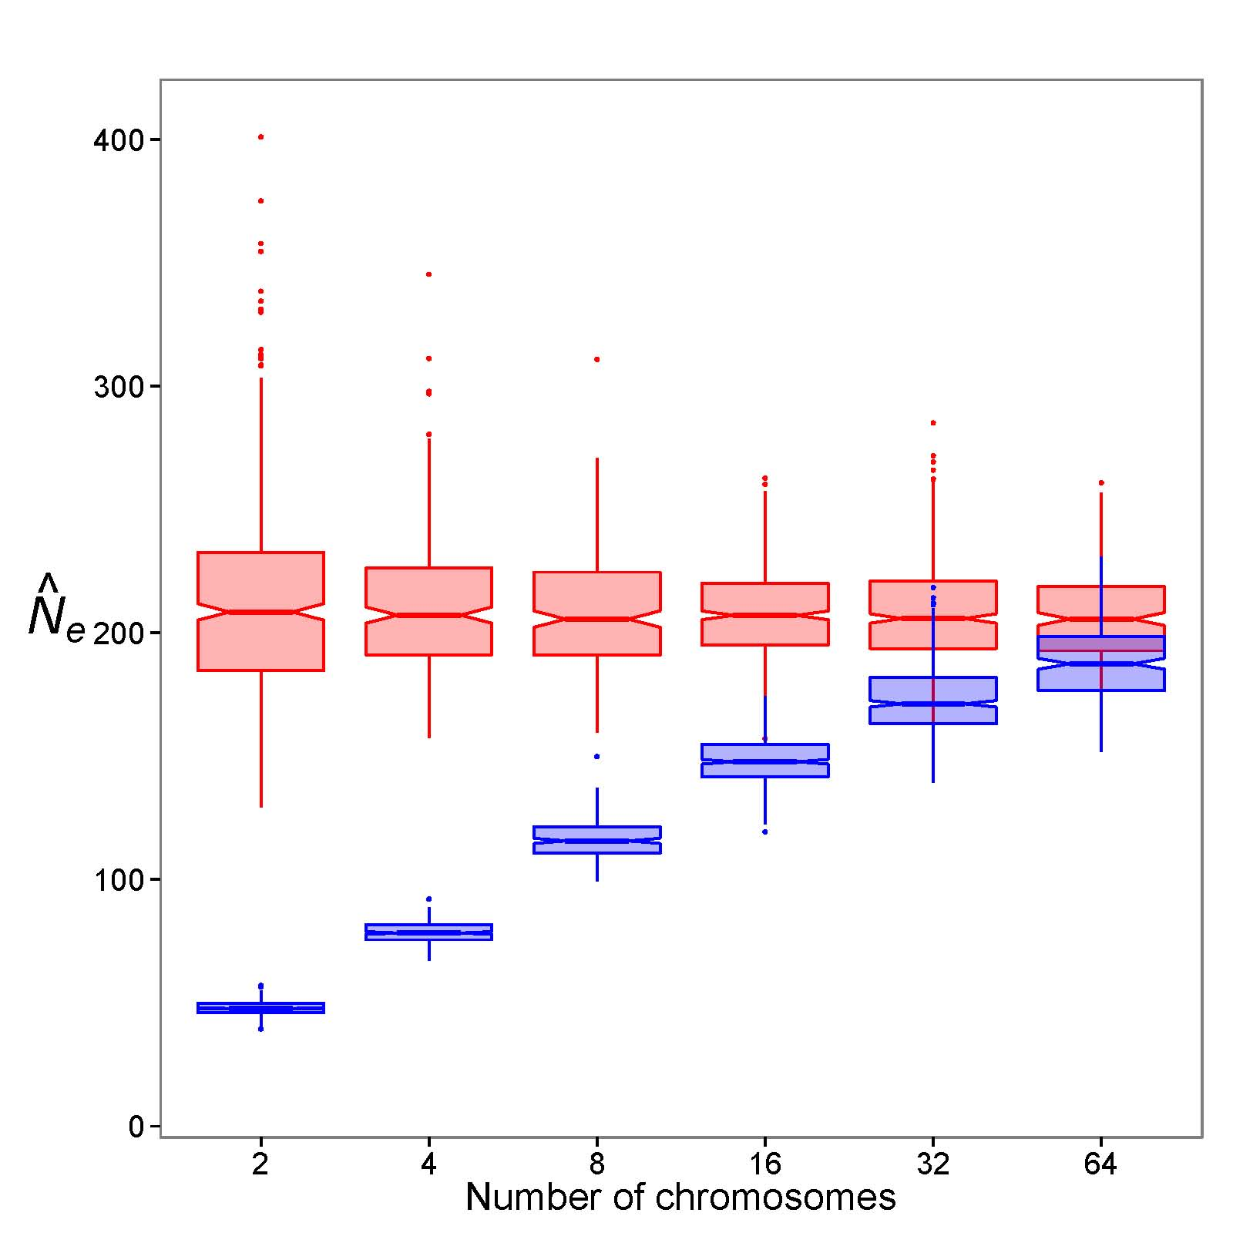
What if you use all the loci?
All loci = blue
Unlinked loci = red

Slide 58
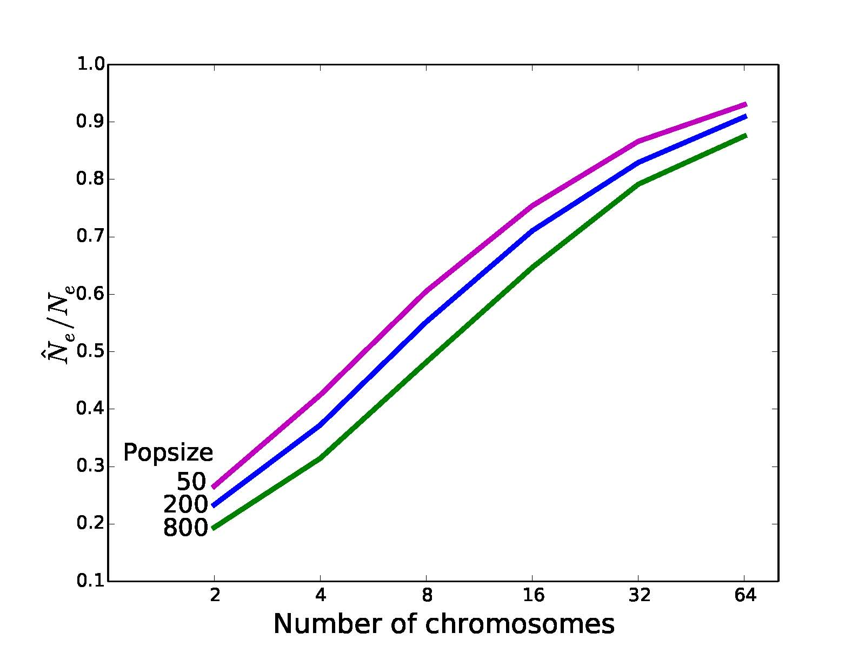
Effect of number of chromosomes on bias is largely independent of actual Nec

Slide 59
Issues regarding precision
For L SNP loci, there are n = L(L-1)/2 pairwise
comparisons, with (supposedly) n df
Theory says Var(mean r²) is proportional to 1/√n
With 10K SNPs, n ≈ 50 million; implies tiny CIs.
But:
  Locus pairs are not independent (1-2, 1-3, 2-3)
  Many loci are linked so information is redundant
Effective df must be much smaller than n, but
nobody knows by how much

Slide 60
Actual vs theoretical
95% CIs for Ne^

Slide 61
Genomics and LD: Summary
More loci do NOT increase the fraction that are linked
Most random pairs of loci are not linked
Linked loci downwardly bias Ne^. Bias from ignoring linkage is less severe when number of chromosomes is large
Strategies to purge outlier pairs of loci are only partially effective
A bias correction factor based on # chromosomes is better
Standard methods for computing CIs overestimate precision for genomics datasets, perhaps to a large degree

Slide 62
Genomics and LD: Summary
More loci does NOT increase the fraction that are linked,
but it does:
        increase the certainty that some loci are linked
        Improves fit between expected and observed distribution of recombination rates
Most pairs of loci are not linked, but loci that are linked downwardly bias Ne^.
Strategies to purge outlier pairs of loci are only partially
effective
A bias correction factor based on # chromosomes is better
Standard methods that don’t account for linkage
overestimate precision, perhaps to a large degree

Slide 64
Software and Exercises
EasyPop (Balloux 2001)
  Simulate data for Ne and population structure analyses
  Illustrate some basic popgen principles
NeEstimator V2 (Do et al. 2014)
  Completely updated
  New single-sample methods and temporal options
  Ready for genomics era

Slide 65
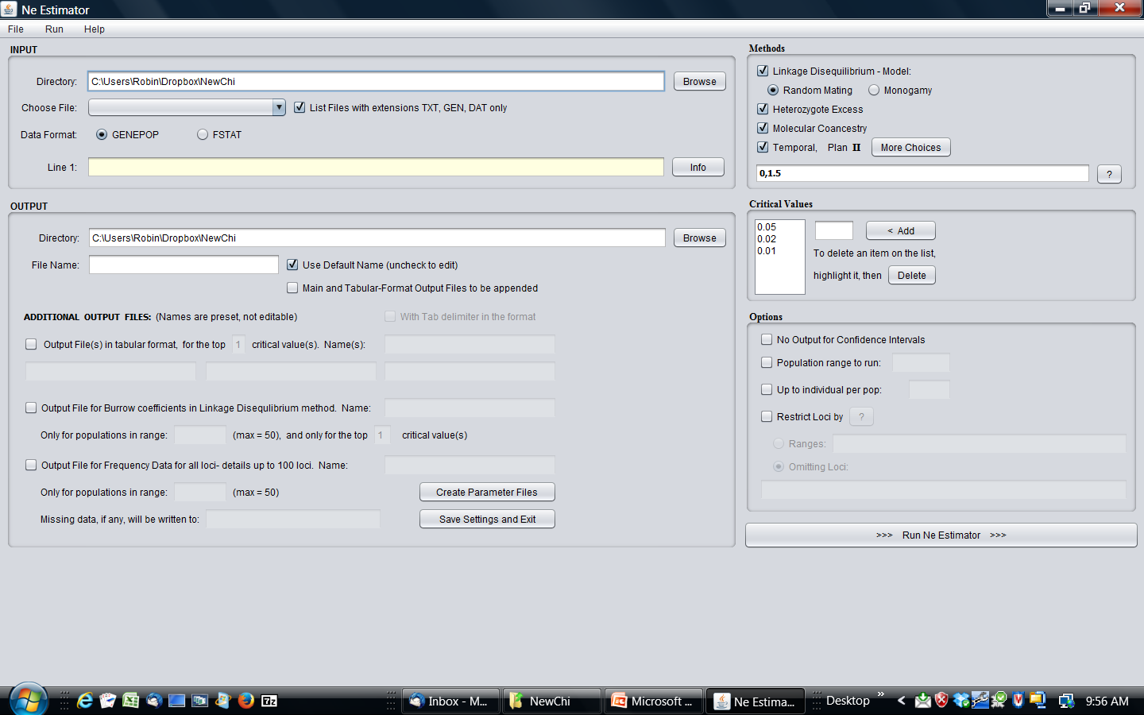

Slide 66
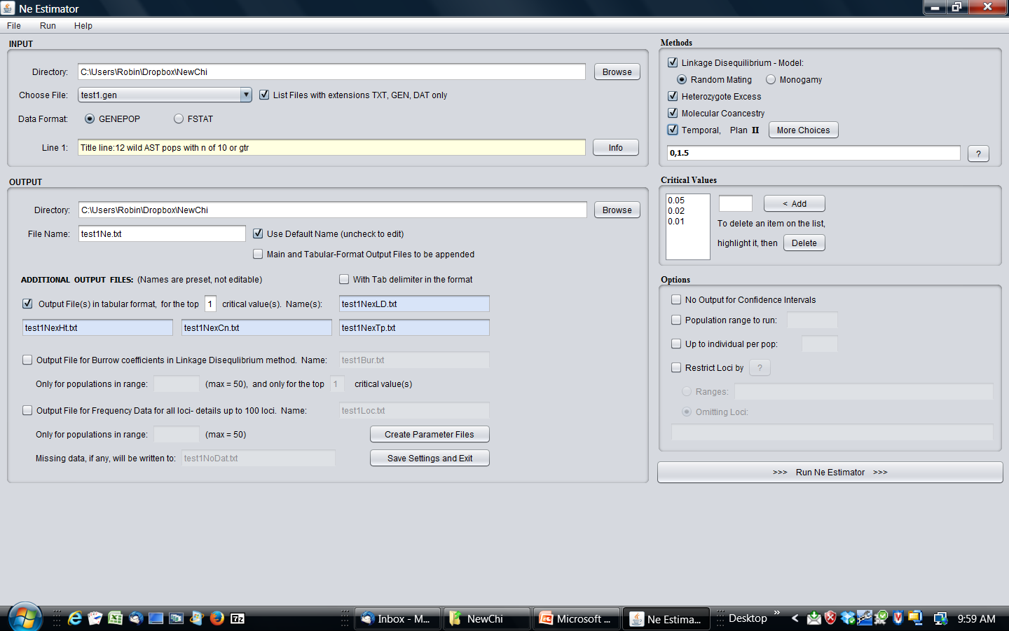

Slide 67
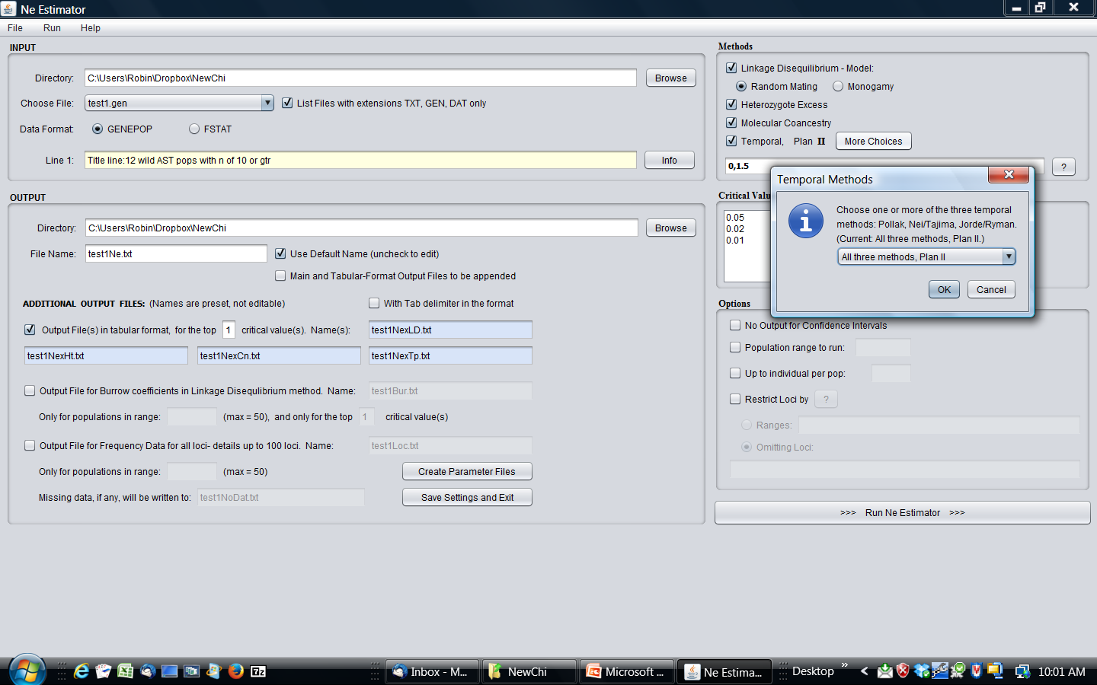

Slide 68
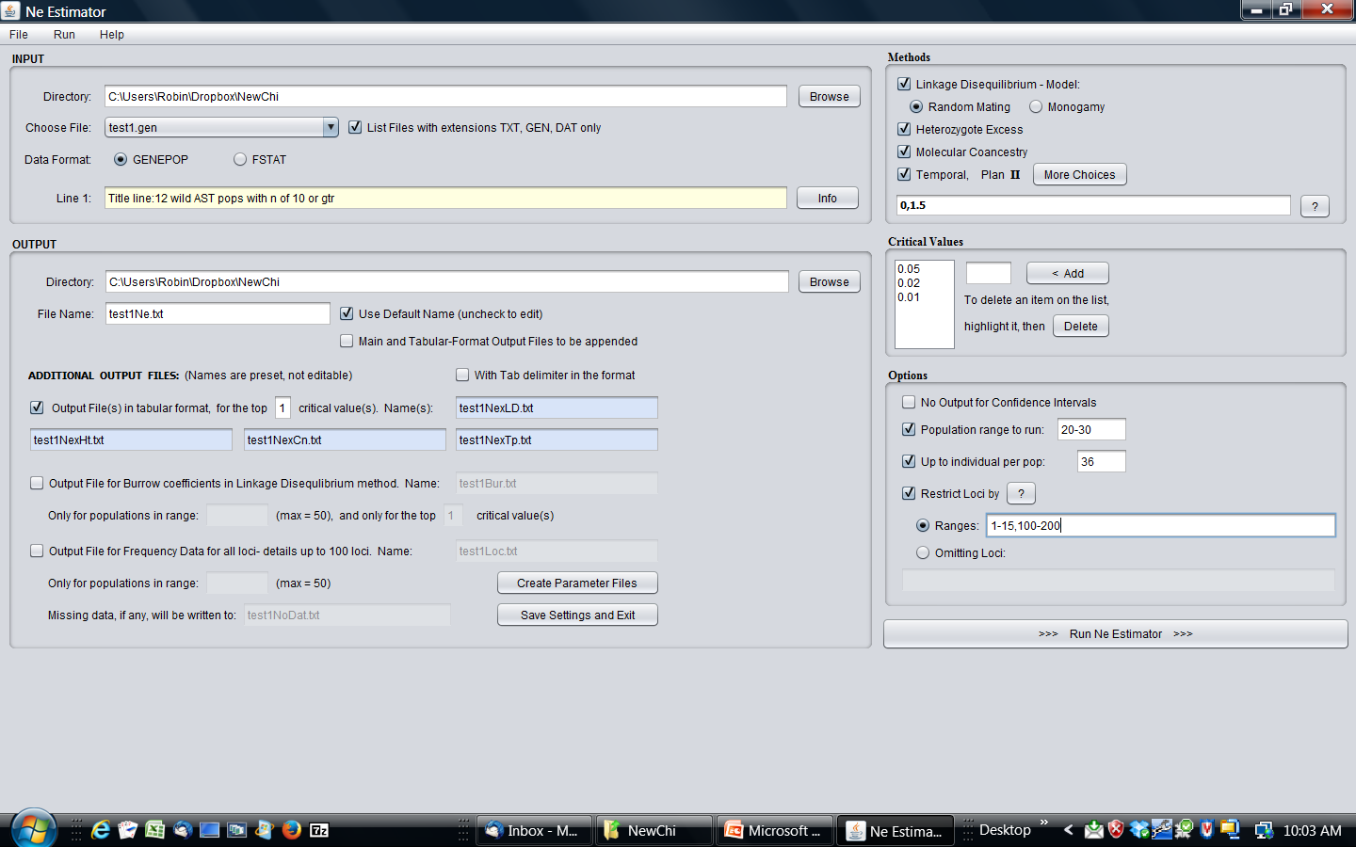

Slide 69
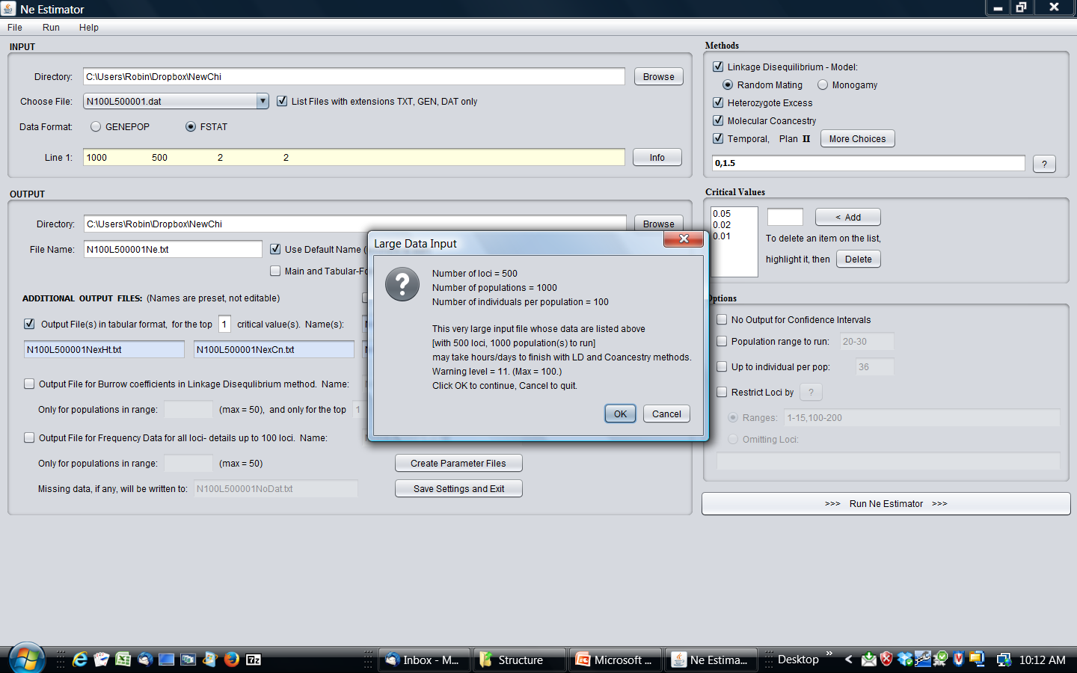

Slide 70
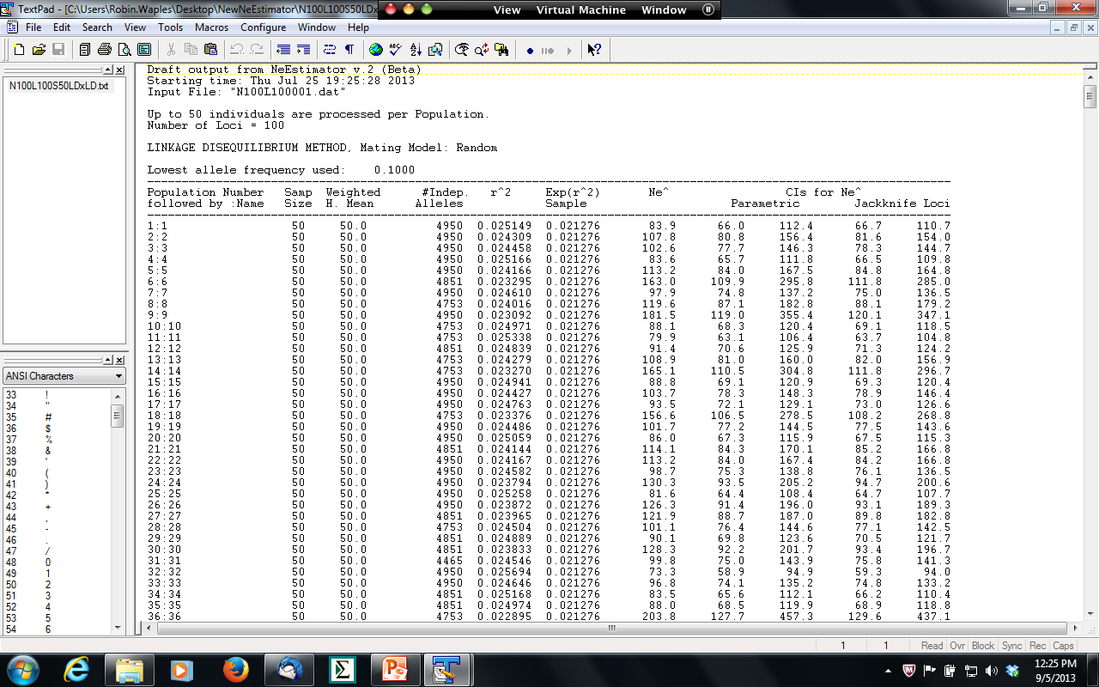

Slide 71
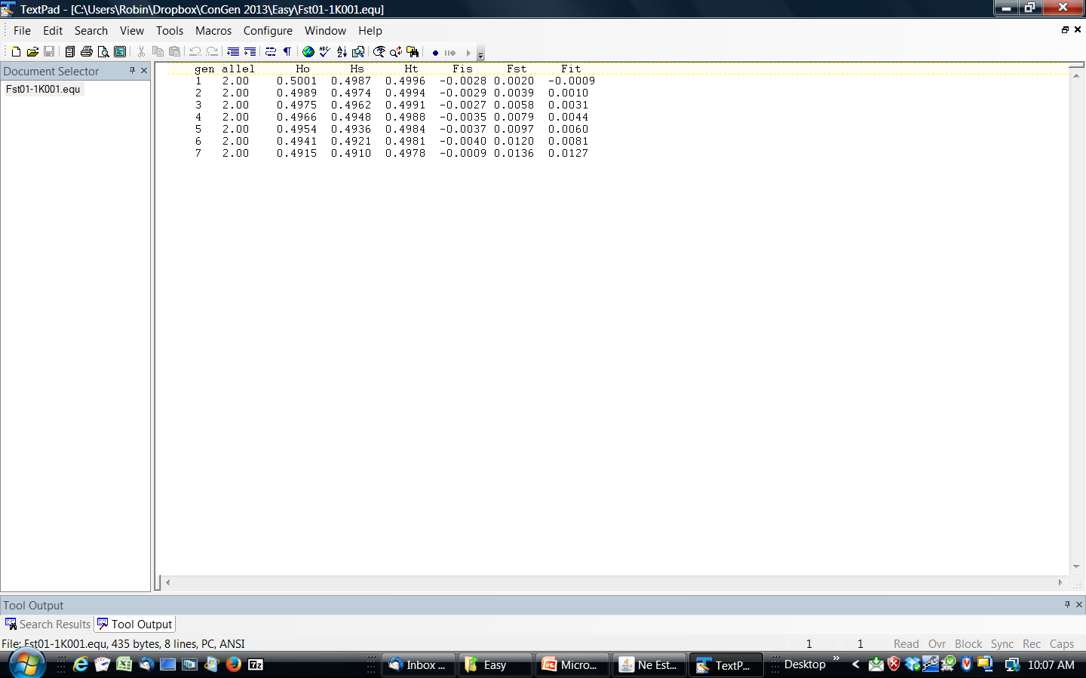

Slide 72
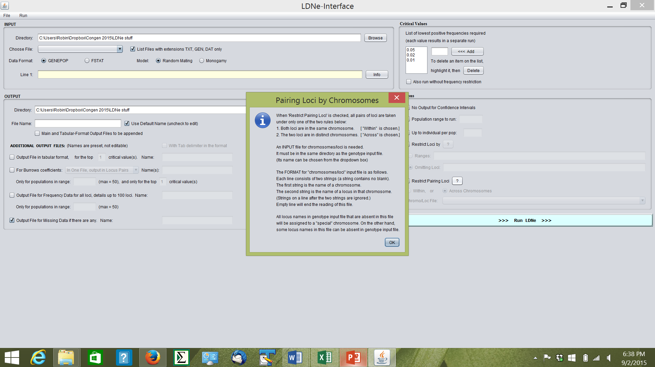

Slide 75
Ne = 200
1%
33%
80%

